Slide 1





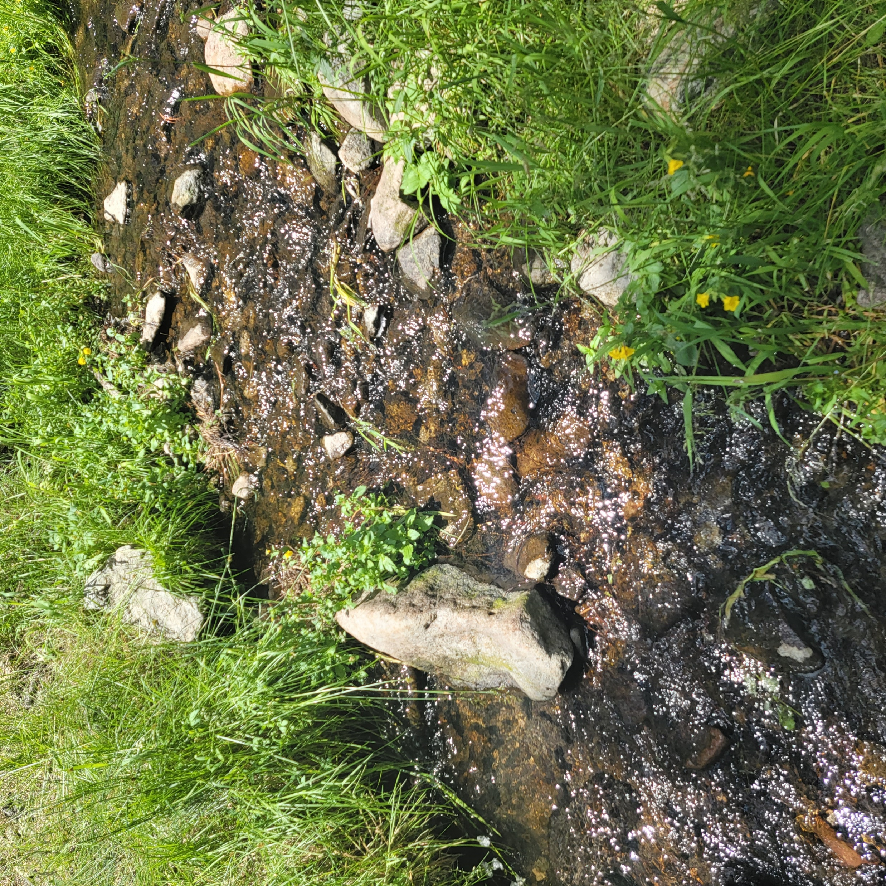
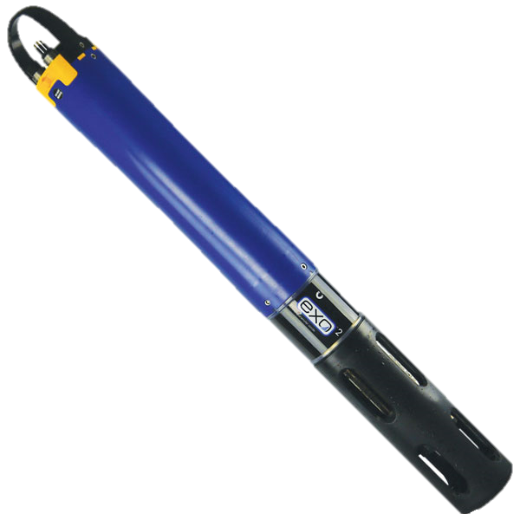
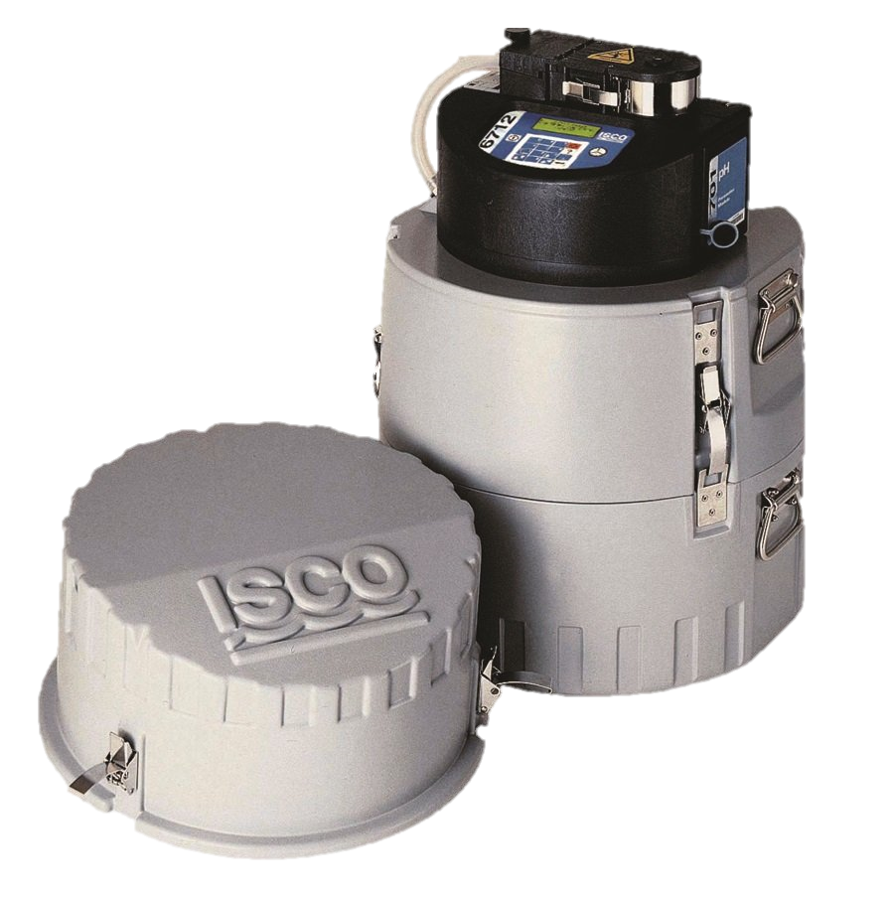
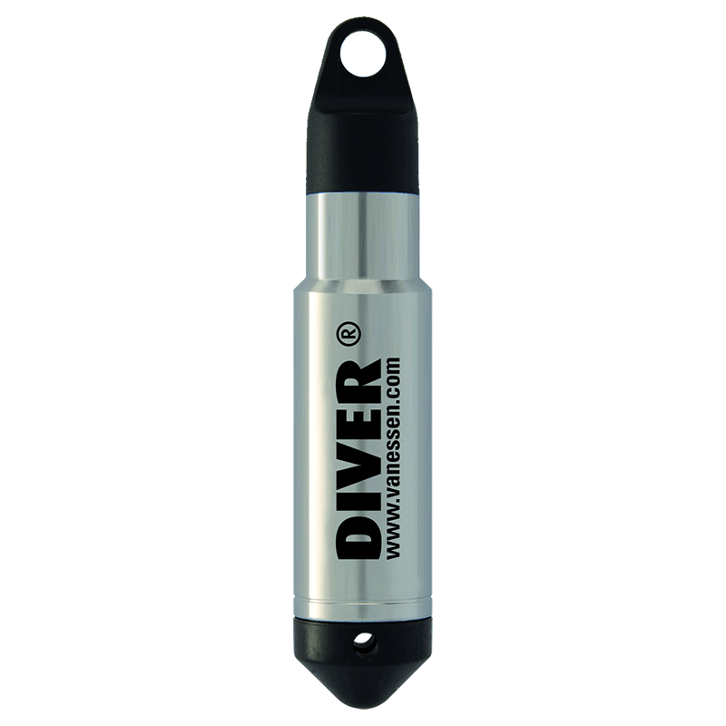
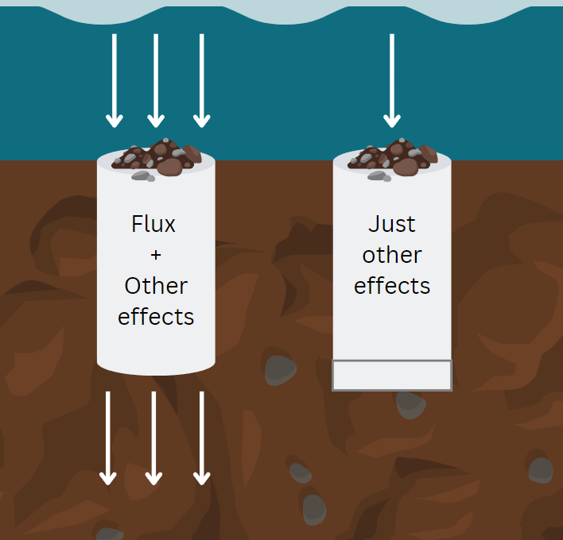
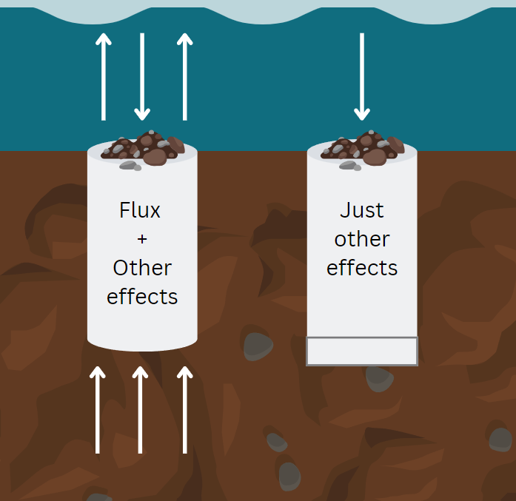
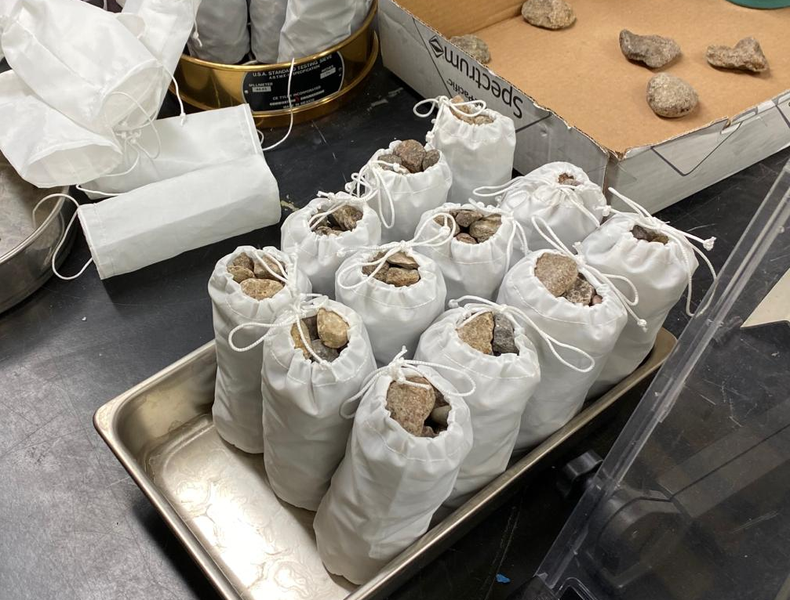
Impacts of streambed dynamics on nutrient and fine sediment transport in mountain rivers
Elowyn Yager^{1*}, Nicole Hucke¹, Rachel Watts², Andrew Tranmer¹, Janice Brahney², Joel Rowland³, George Perkins³ and Rose Harris³
¹University of Idaho, Boise, ID
²Utah State University, Logan, UT
³Los Alamos National Laboratory, Los Alamos, NM
Environmental System Science Program
Summary
The armor layer protects the finer bed subsurface from erosion, but when dislodged during high flow events it can release fine sediment enriched in Phosphorus (P) and Organic Carbon (OC).
Hysteresis and seasonal variations in particulate and soluble reactive phosphorus (PP and SRP) and in particulate and dissolved organic carbon (POC and DOC) could be controlled by armor layer motion
By monitoring summer monsoon and snowmelt flows and conducting field experiments in a mountain stream in NM, our preliminary results suggest that the quantity of fine sediment in the riverbed is related to local hyporheic flux and near-bed flow velocity.
Particulate constituents such as POC, PP and suspended sediment (SS) often show clockwise hysteresis, whereas DOC tend to show counter-clockwise hysteresis, suggesting them coming from different sources.
We are currently investigating these sources and constraining the exact timing of armor layer motion in each event.
Image 1
Methods
Study Site: La Jara Creek,
Valles Caldera National Preserve, NM
1. Capturing Hysteresis:
Turbidity and fDOM*
Laboratory Procedures
Collected using a YSI EXO2 Sonde
SS – Laser diffraction
method (LISST portable XR)
POC – Eurovector elemental analyzer coupled to an Isoprime IRMS
DOC – OI Analytical Aurora 1030 TOC Analyzer
SRP & PP – SpectraMax M2e
Subheading
Water samples (SS, SRP, PP, DOC & POC)
Stage-triggered portable ISCO samplers
Bulleted body text
Bulleted body text
Flow depth and Discharge
Pressure transducers in stilling wells
* Fluorescent dissolved organic matter – a reliable proxy for DOC
2. Fine Sediment Deposition
Sediment traps with open and closed bottoms were installed next to subsurface temperature probes during the spring of 2023
Downwelling Conditions
Upwelling Conditions
Other deposition effects:
settling velocity
stream turbulence effects
3. Computing Hyporheic Flux
Image 3
Bulleted body text
Bulleted body text
Footer, showing project banner and/or listing acknowledgements, references, etc.

